Slide 1
A Series of Unfortunate Events in Complex Networks
Robustness Metrics for Cascading Failures
Inês Ferreira Ricardo Santos

Slide 2
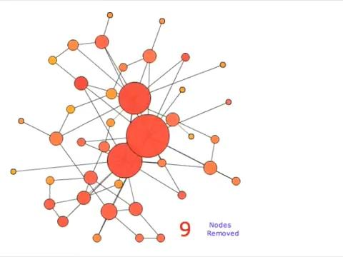
Removing nodes one by one
Real-world networks are robust to random failures
For targeted attacks, removing a minimal amount of nodes cripples the network.

Slide 3
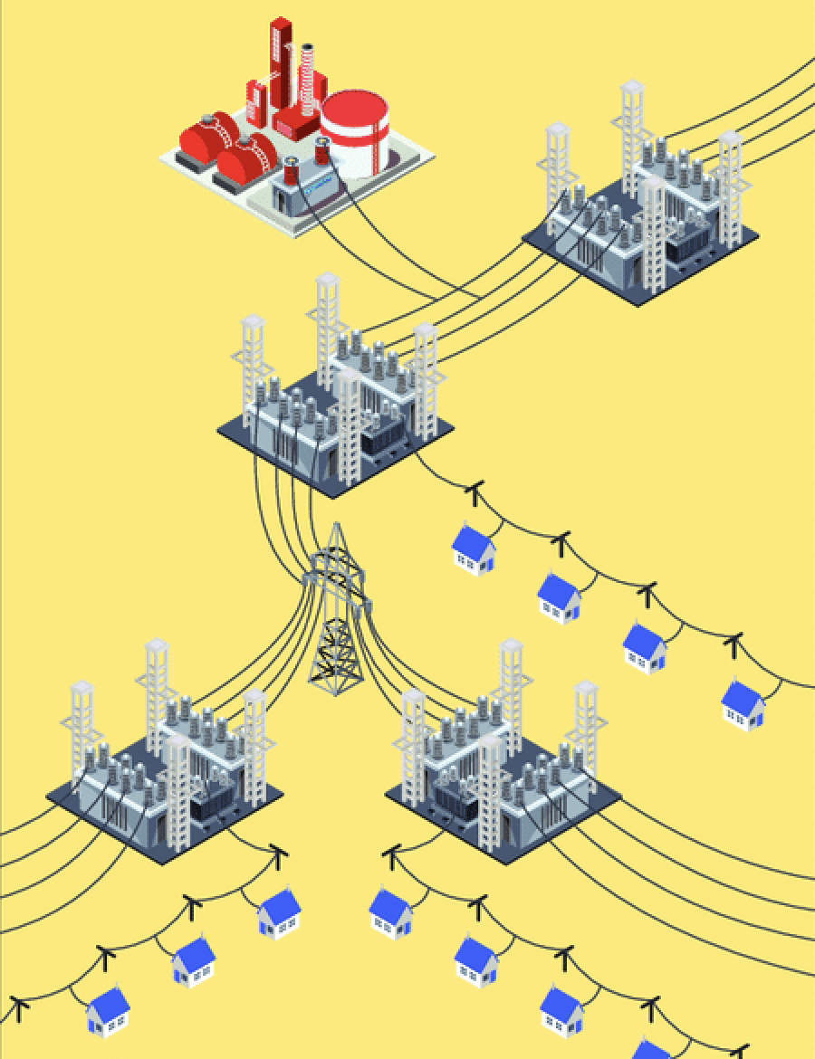
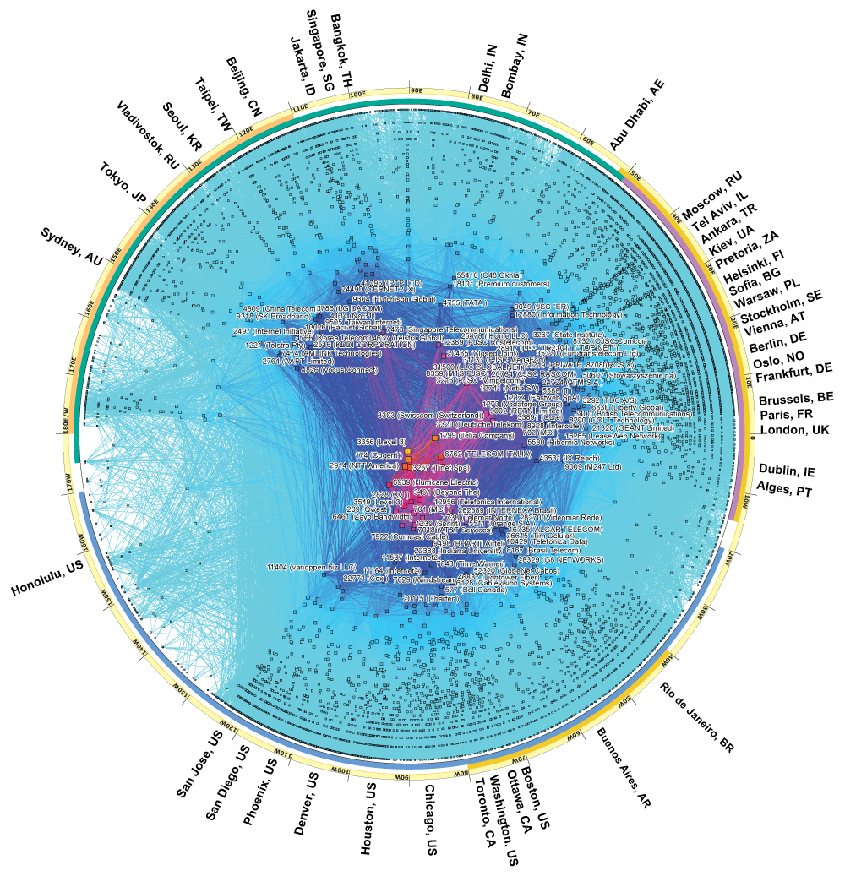
Networks as transportation systems

Slide 4
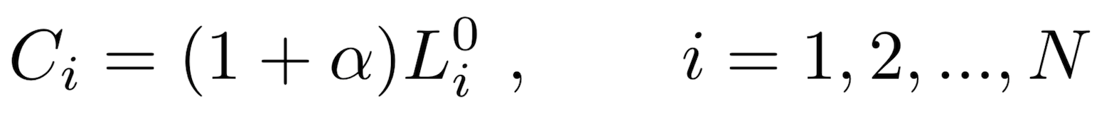

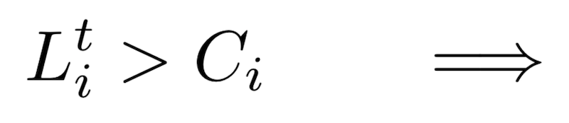
The Motter-Lai Model

Slide 5
How to choose the initial node to attack?
Random
Degree
Betweenness Centrality (Load)
Clustering Coefficient

Slide 6
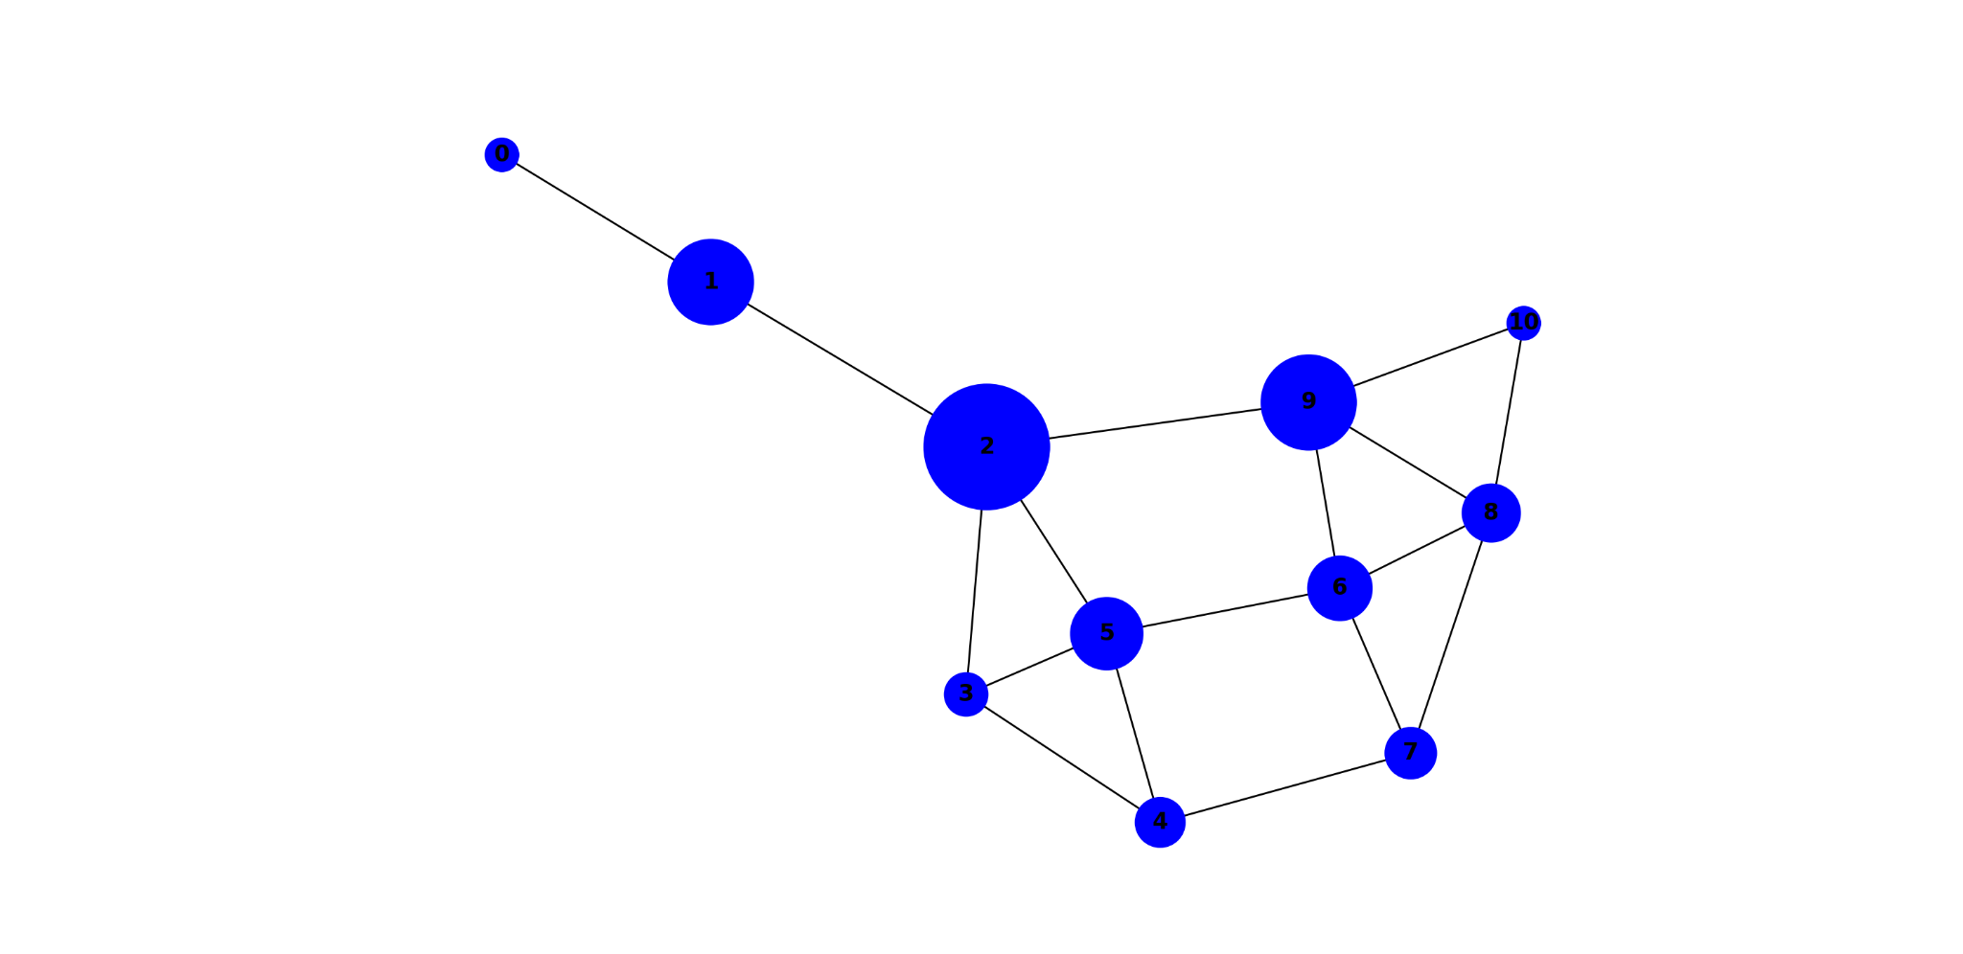
Algorithm

Slide 7
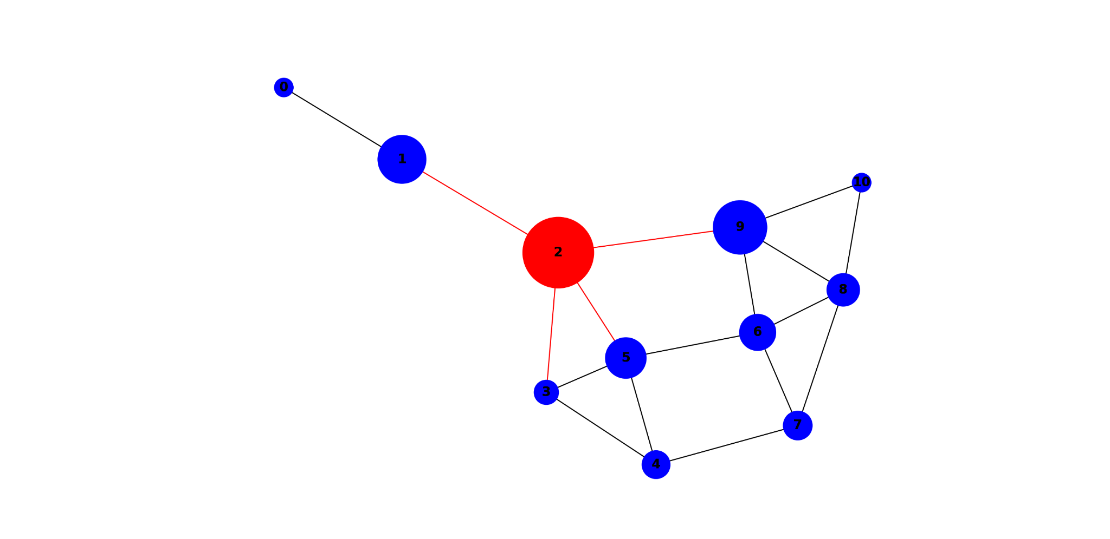
Algorithm

Slide 8
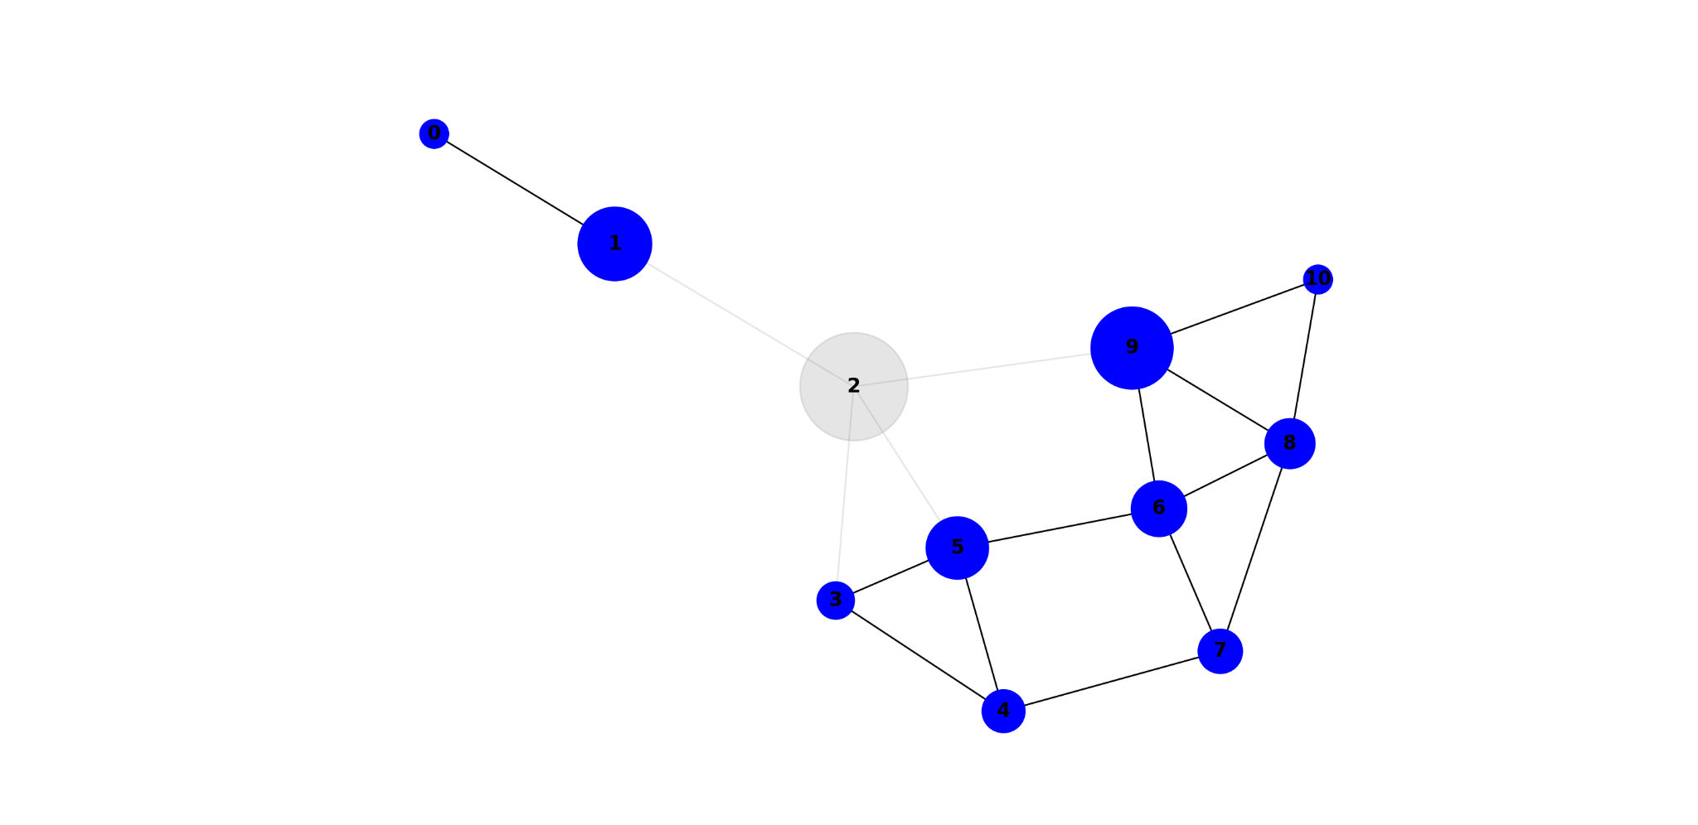
Algorithm

Slide 9
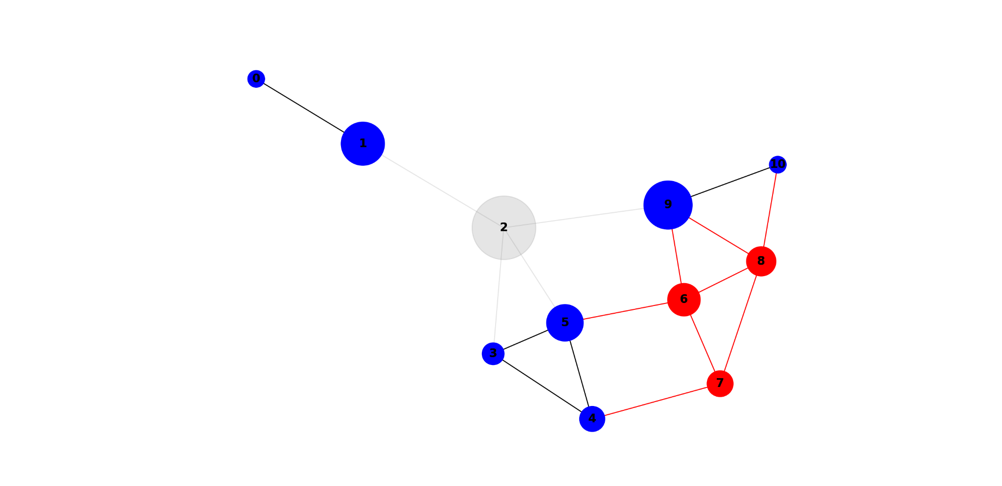
Algorithm

Slide 10
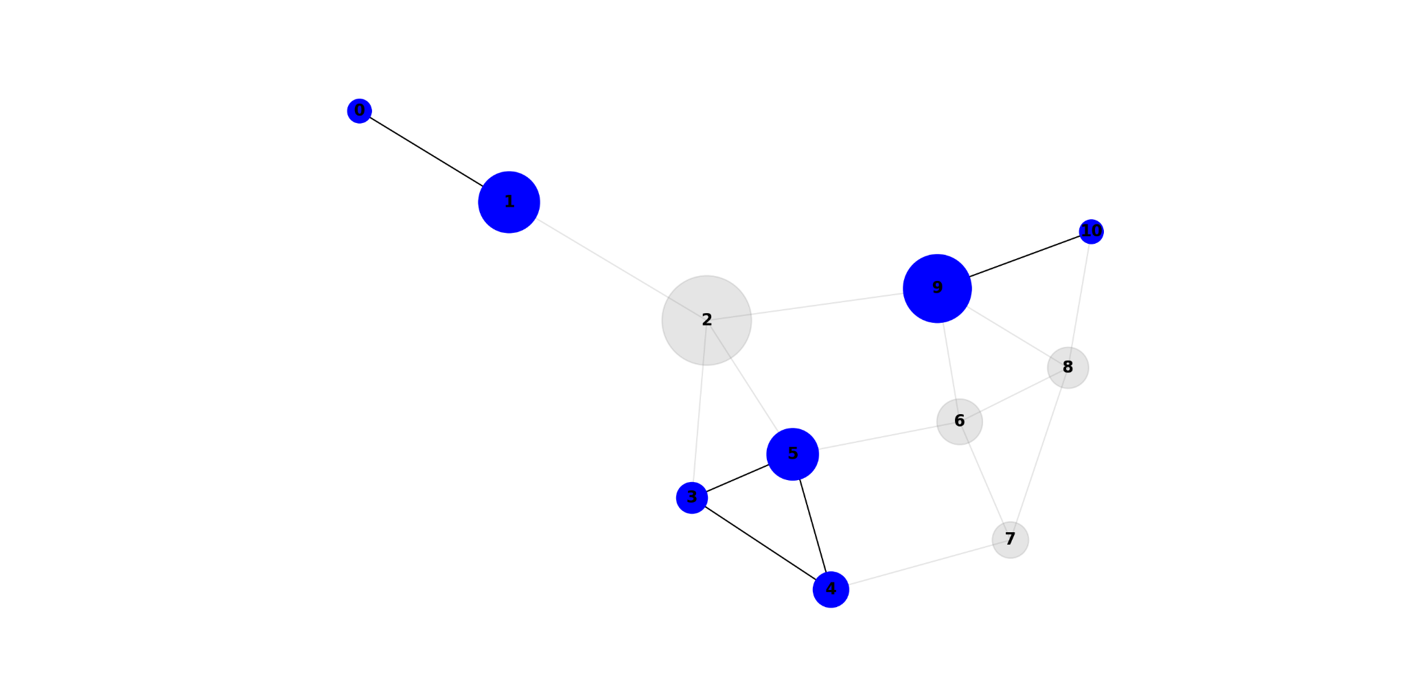
Algorithm

Slide 11
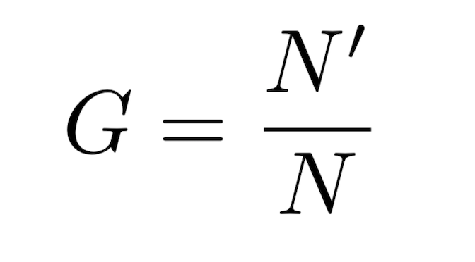
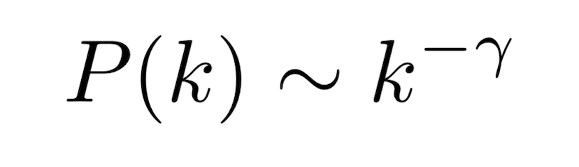
The Giant Component Metric
How to evaluate the robustness of a network?
What models to use for testing?

Slide 12
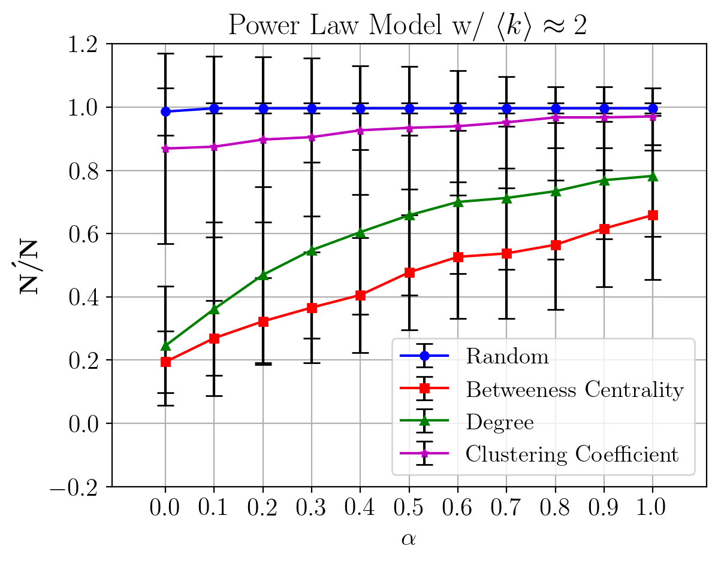
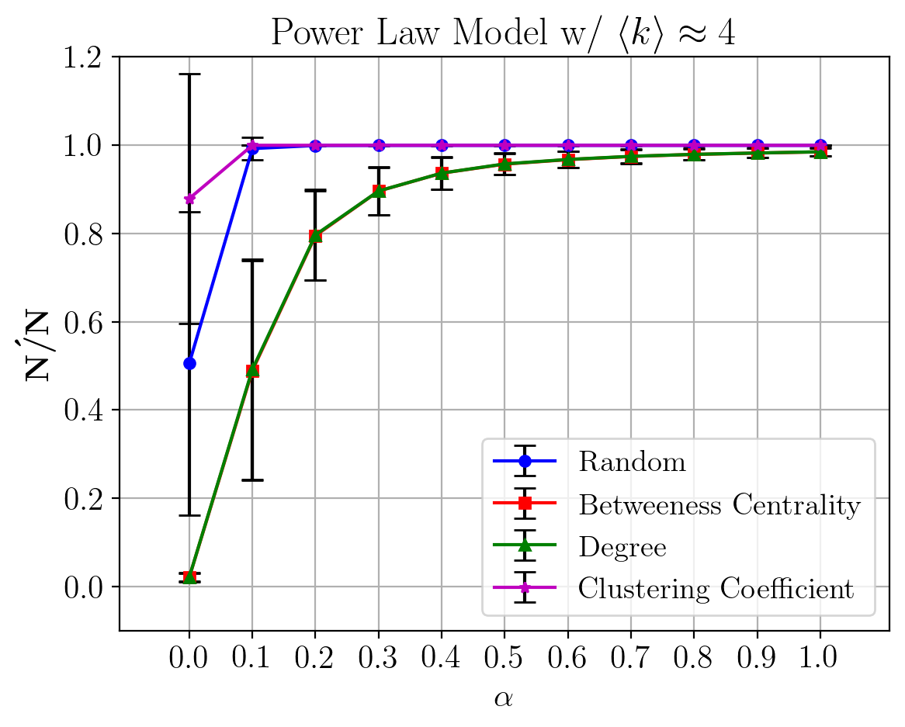
Power Law Avg. Degree 2 VS 4 (N = 5000)

Slide 13
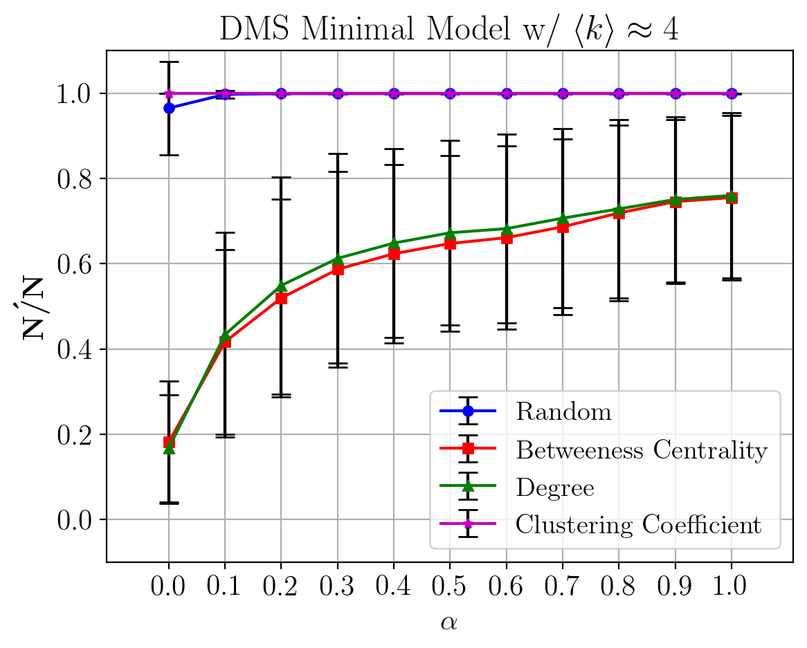
Power Law VS DMS (Avg. Degree 4, N = 5000)

Slide 14
Power Law VS DMS (Avg. Degree 4)
The DMS Model seems less robust to targeted attacks...
What about if we use a different metric?
Will the results be the same?

Slide 15
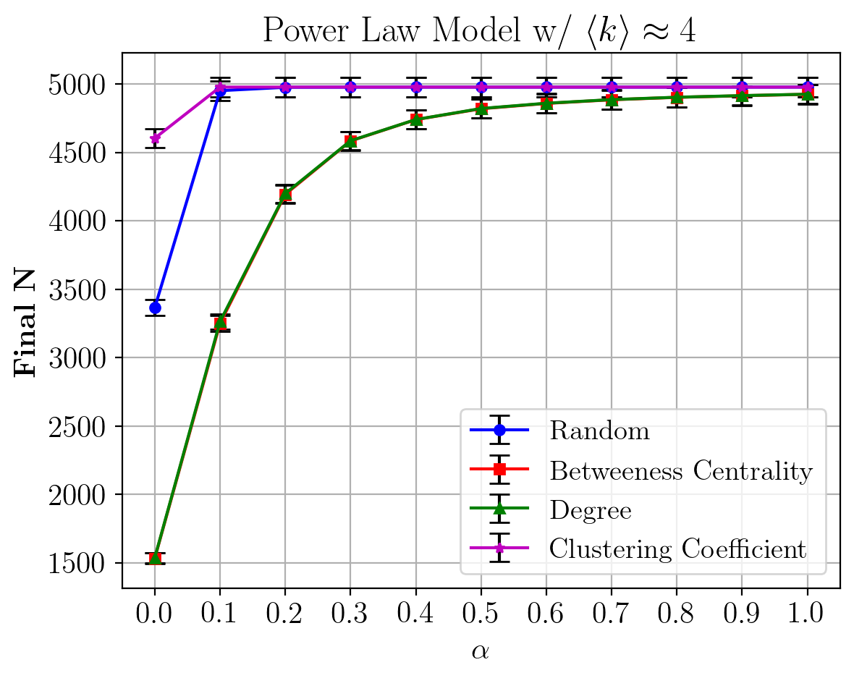
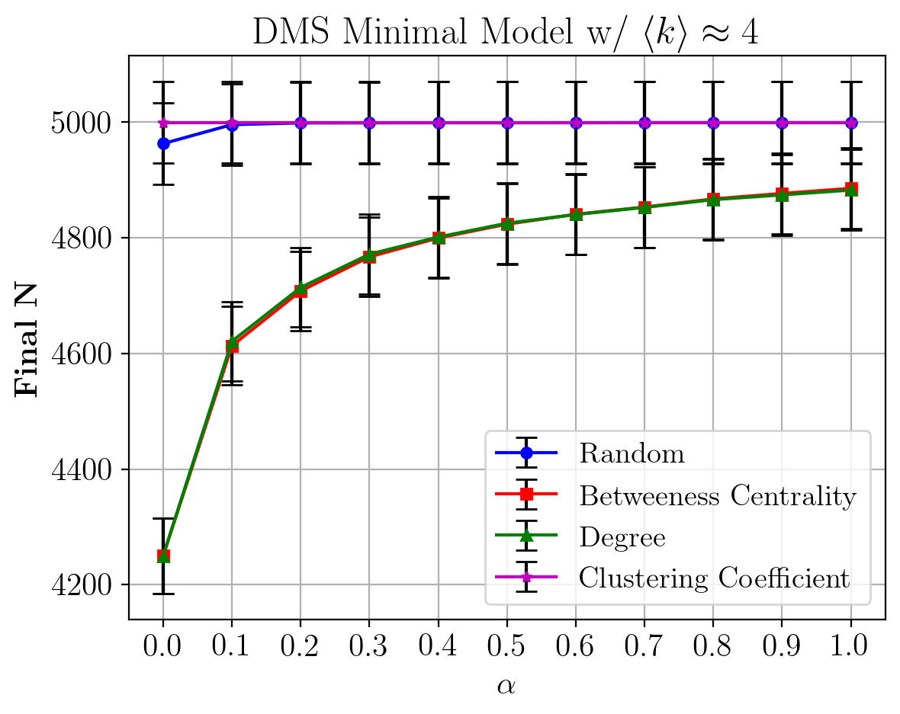
Power Law VS DMS (Avg. Degree 4)

Slide 16
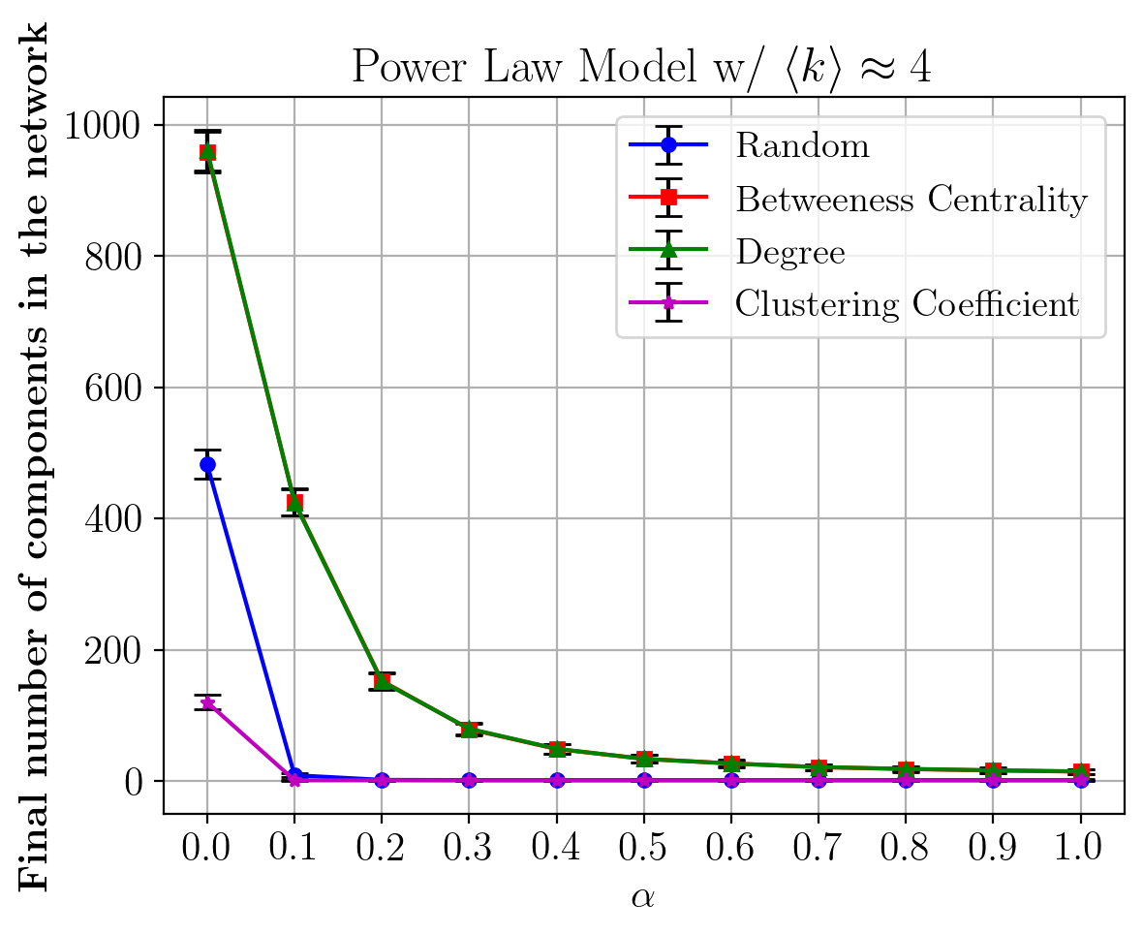
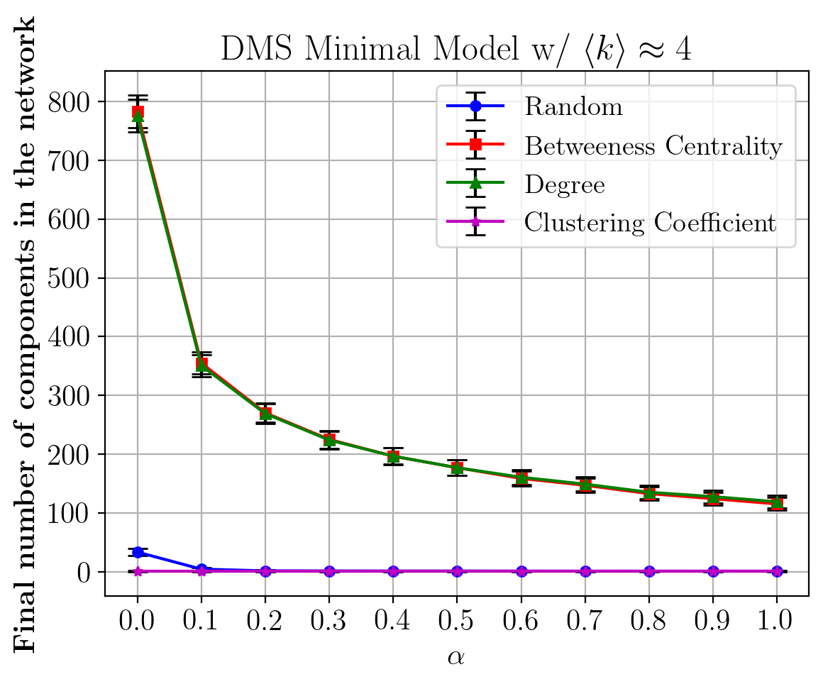
Power Law VS DMS (Avg. Degree 4)

Slide 17
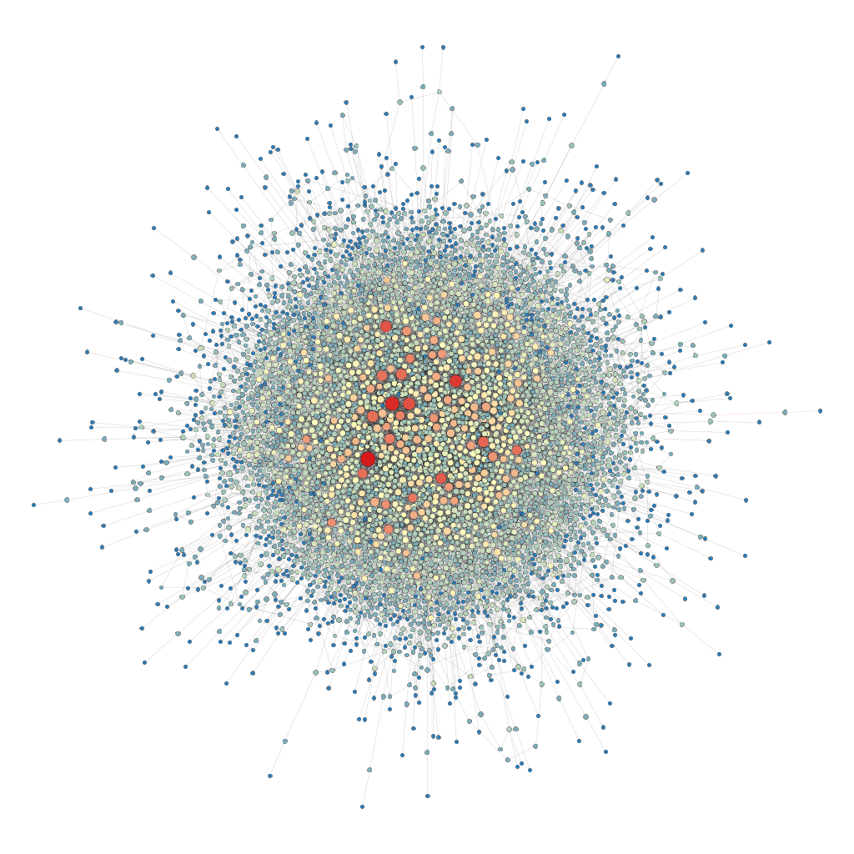
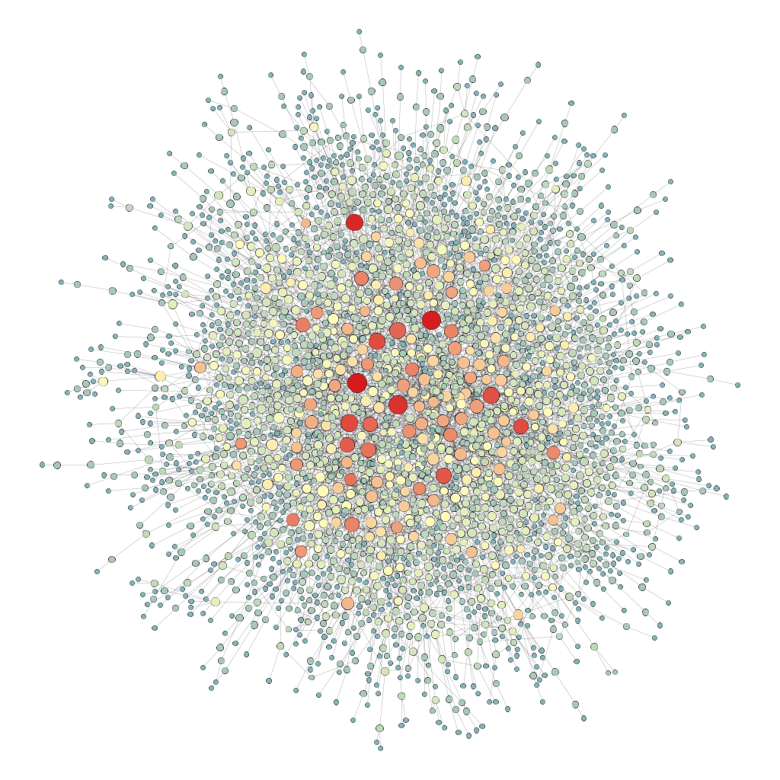
Power Law - Load-based attack - 𝛼 = 0.2 - N = 5000
Initial
Final

Slide 18
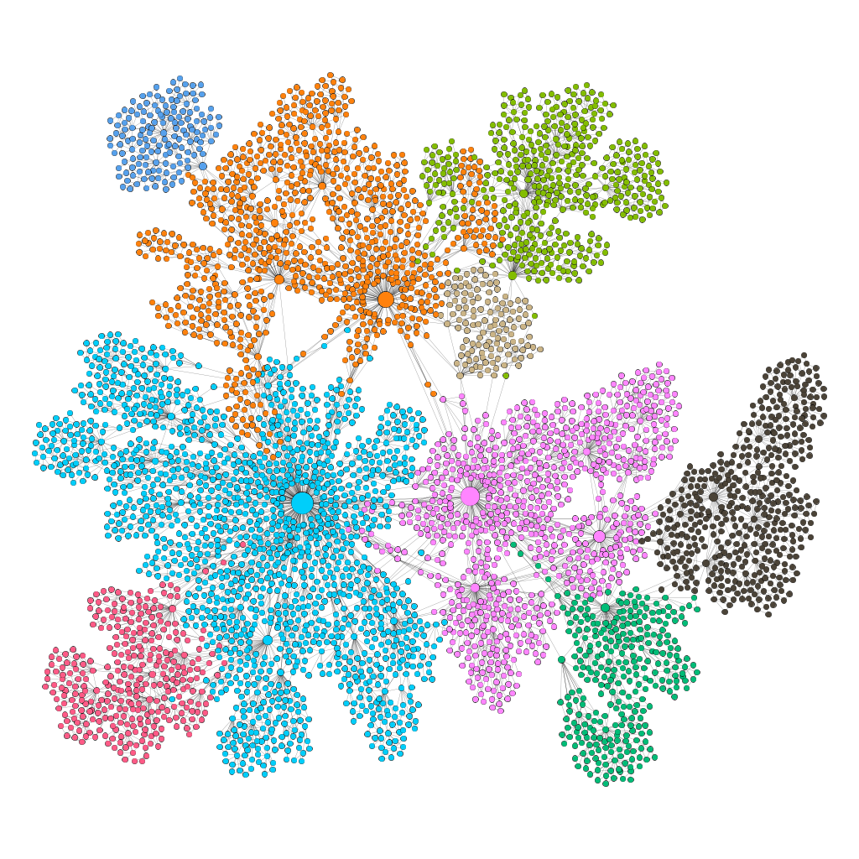
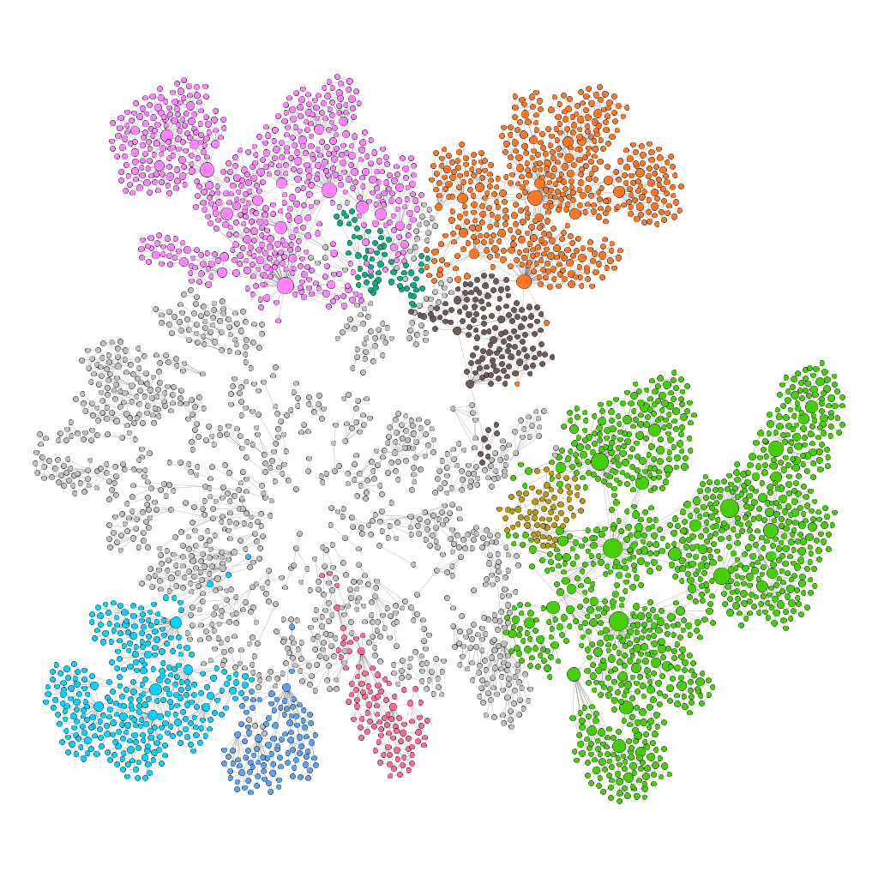
DMS - Load-based attack - 𝛼 = 0.2 - N = 5000
Initial
Final

Slide 19
Power Law and DMS comparison for 𝛼 = 0.2
Final values | Power Law | DMS
# of Nodes | 3193 | 4483
# of Nodes w/ k > 0 | 2995 (94%) | 4125 (92%)
# of Nodes in biggest comp. | 2751 (86%) | 1095 (24%)
# of Components | 83 | 175
Average Degree | 2.695 | 3.411

Slide 20
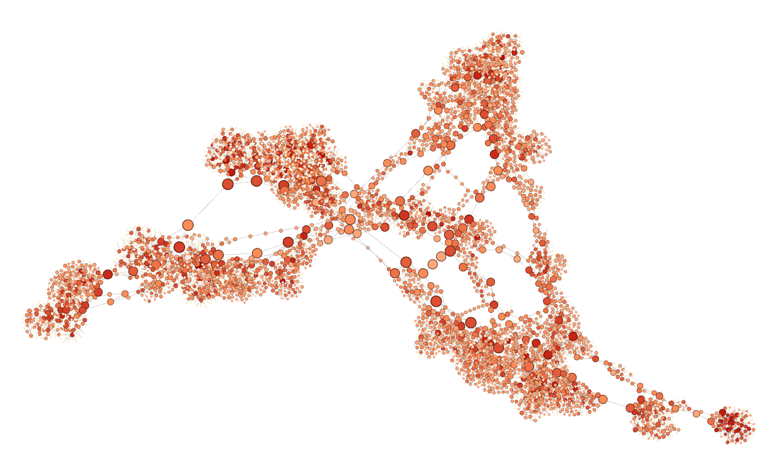
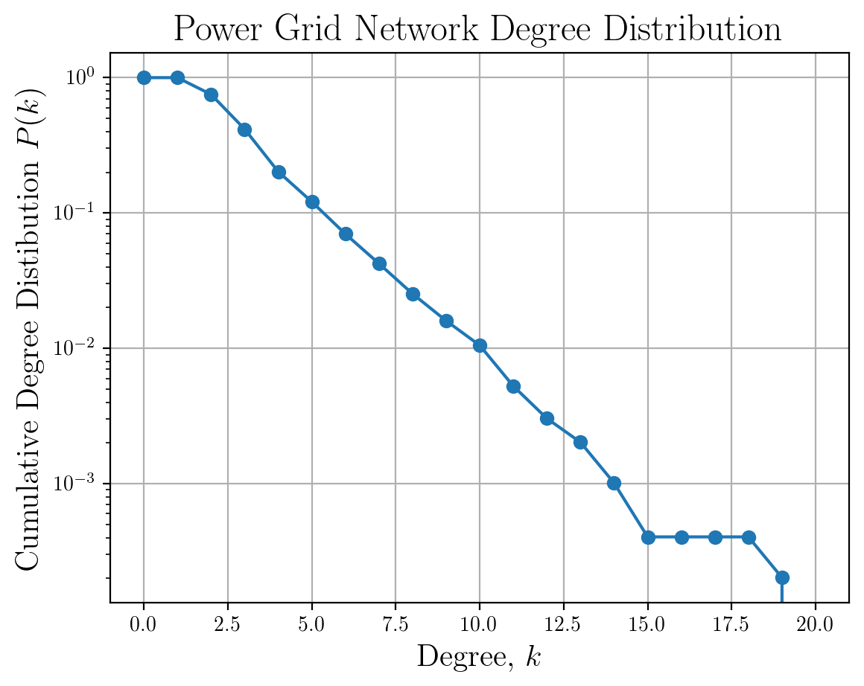
Power Grid
N = 4941
<k> = 2.67

Slide 21
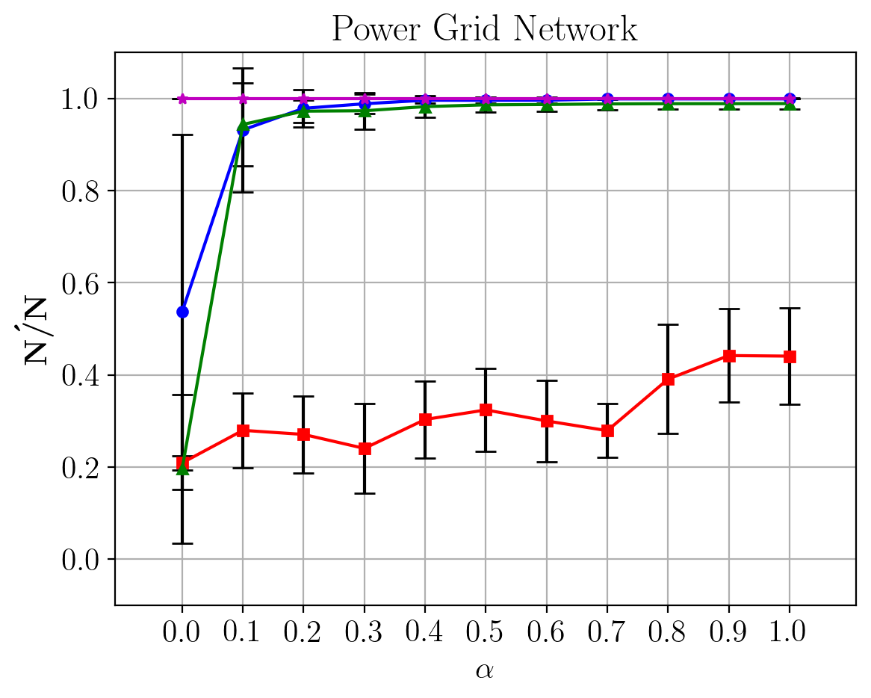
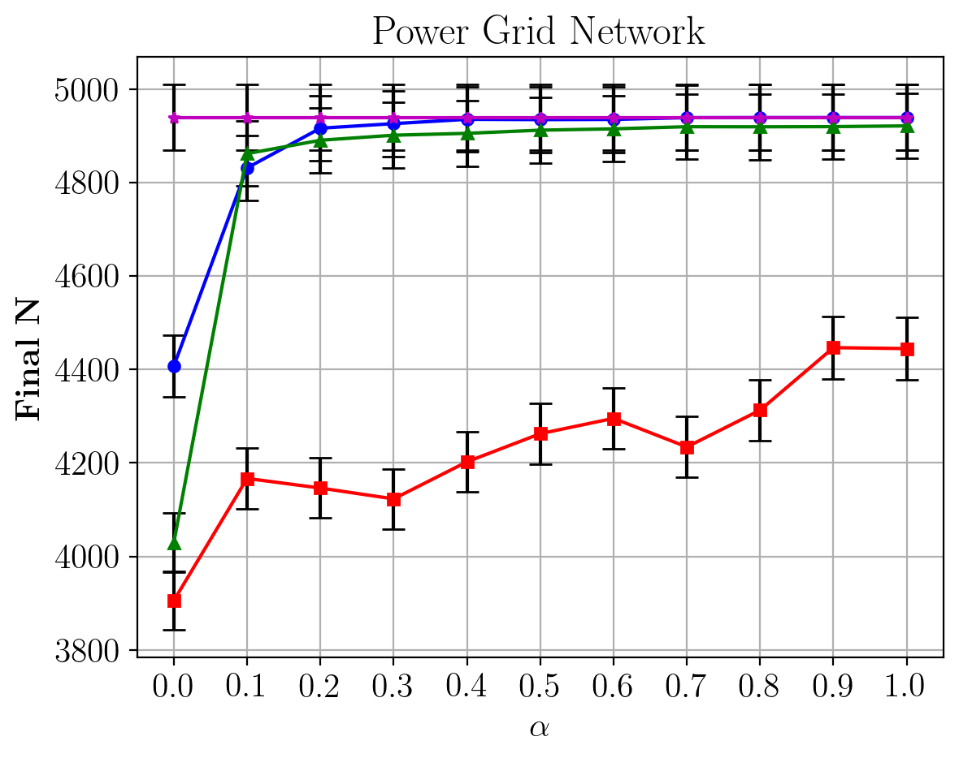
Power Grid

Slide 22
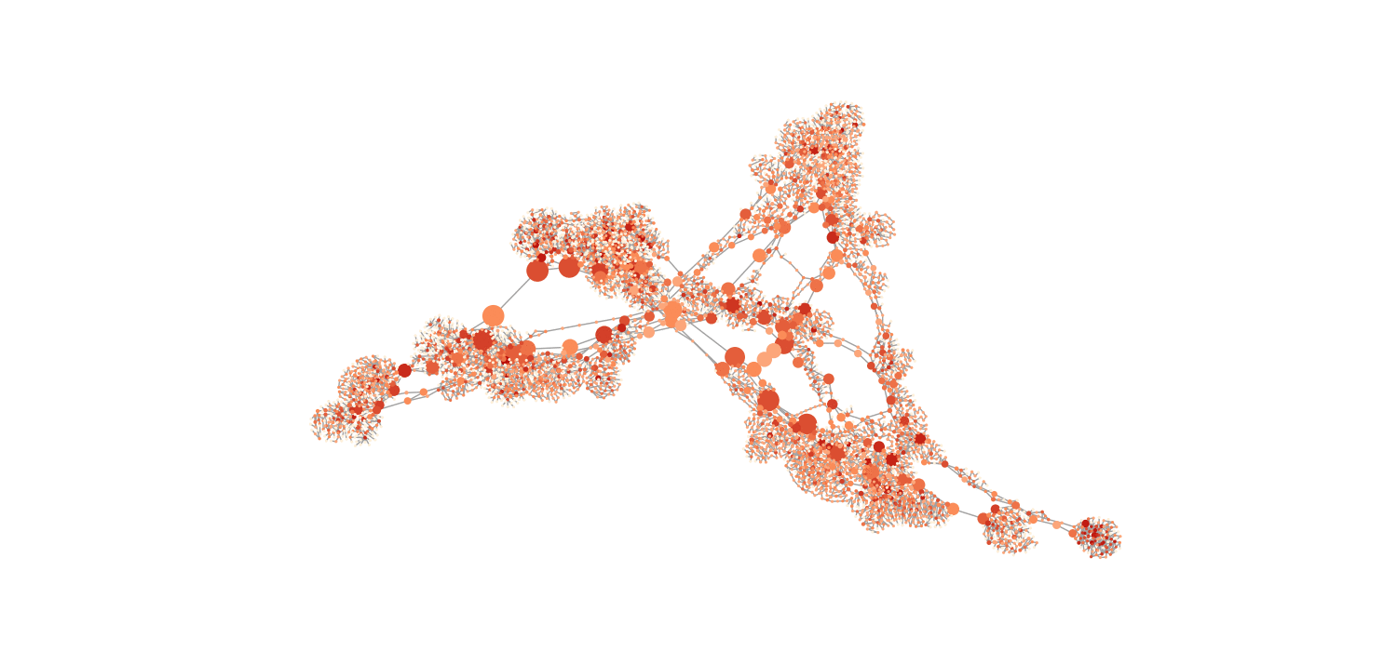
Power Grid - Load-based attack - 𝛼 = 0.2

Slide 23
Conclusion
How to attack a network?
Degree
Betweenness Centrality
Higher degree ⇒ More robustness
Robustness ⟺ Number of nodes ⇒ Choose a DMS Model
Robustness ⟺ Size of the giant component ⇒ Choose a Power Law Model

Slide 24
Thank you!

